Slide 1

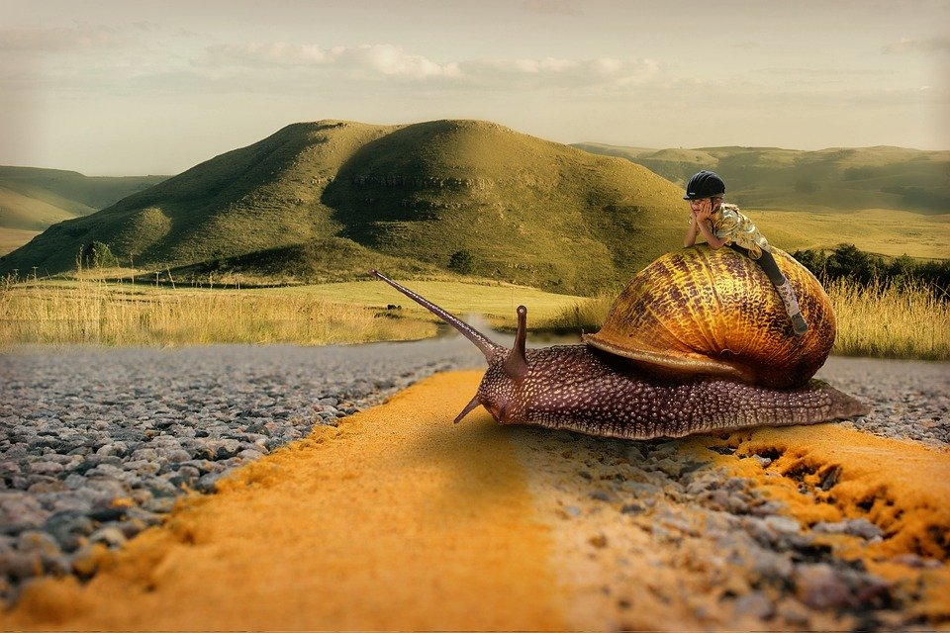

Tijd
Fijn dat je er bent!

Slide 2
Tijd

Slide 3


Slide 4

Candle of Life – Moody Blues
Something you can't hide
says you're lonely
Hidden deep inside
of you only
It's there for you to see
take a look and be
Burn slowly the Candle of Life

Slide 5
Something there outside
says we're only
in hands of time
falling slowly
It's there for us to know
with love that we can go
Burn slowly, the Candle of Life
So love everybody and make them your friends

Slide 7


Slide 8


Slide 9

Fijn dat je er was,
we zien je graag terug!
Volgende week:
Taizé

